Slide 1
Ecogame
Unfolding and rules of the game

Slide 2
Game scenario
EcoGame puts you in the place of four villages’ head. You have the role to take decisions regarding your village, especially when it comes to agricultural production and pollution
Your four villages are regrouped in a commune on which the main economic strength is its agricultural production
You are sharing the territory of an imaginary commune on which you are trying to make efforts to meet an very important agricultural label : EcoLabel
This label is given to the commune when specific criterias are met. These criteria are evaluated for the whole commune, based on each villages’ criterias
However, the requirements to meet this label’s criteria are hard : you meet today because you are about to lose this label due to a decreasing production and an increasing pollution

Slide 3
Game settings and players’ objective
4 – 12 players divided in 4 groups
Each group plays the role of a village head
The game is led in 8 rounds. One round represents one year in the territory

Slide 4
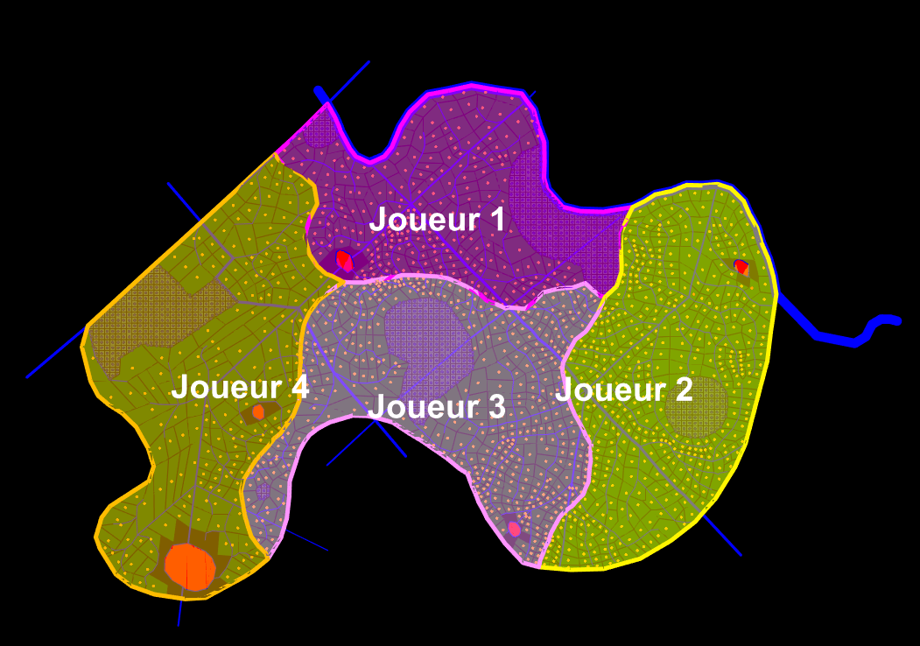
Functionning of the territory
The commune is imaginary
It is divided in 4 villages. Each village is led by one group

Slide 5
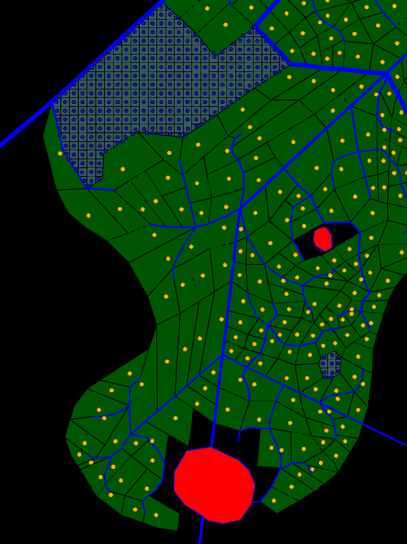
Functionning of the territory
The territory is composed by several entities :
Urban areas
Local landfills
(1 little red circle for each village)
Fields
(yellow dot = 1 farmer/field)
Communal landfills
(1 bigger red circle for the commune, located in village 4)
Irrigation canals

Slide 6
Functionning of the territory
The inhabitants (urban areas) and the farmers (fields) produce two types of wastes : solid waste and wastewater
These different types of waste are distributed differently on the territory
Farmers throw :
Solid waste and wastewater in canals
Solid waste and wastewater on the fields
Inhabitants throw :
Solid waste and wastewater in canals
Solid waste on the urban areas’ ground

Slide 7
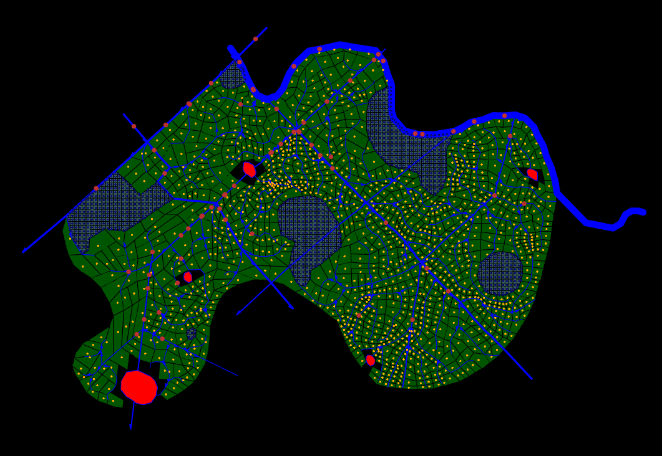
Functionning of the territory
Every week, some of the urban areas’ waste is transferred to the local landfill and then to the communal landfill
Landfills have an impact on the fields’ production nearby, so that the more waste is accumulated, the less these fields will produce
Global pollution has an impact on the villages’ ability to produce agricultural goods. This pollution can either stay in the original village or travel to other villages through canals
The canals have a specific way to make wastes travel throughout the territory (see on presentation model)

Slide 8
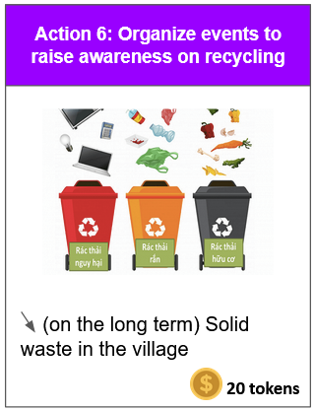
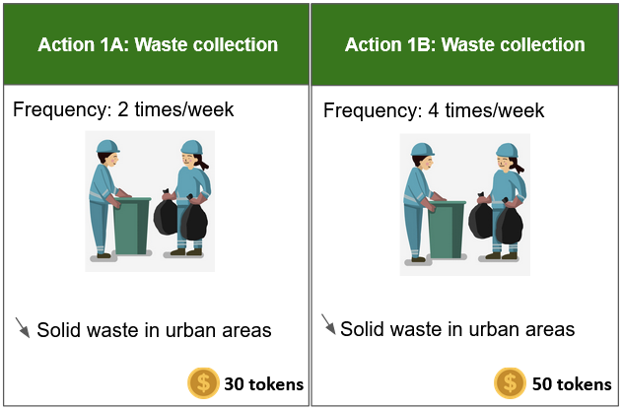
Players’ objective and actions
Players’ objective : take actions every turn to meet the EcoLabel criteria linked to pollution and production
Each player has in their posession a deck of 9 actions that have different impacts on pollution and production

Slide 9
Players’ objective and actions
Each action have a different impact on pollution or production, sometimes both
Some actions can have different levels of impact. A lower impact also means the action is less expensive to take
The actions taken by each group have an effect on the following year, or on the long term in the game. The long terms actions are marked with a star next to the card’s title
To understand better the functionning of each action, we divided in three parts :
Mandatory actions : actions 1, 2 (when the players negociated to take it). They are taken at the begining of every turn, before any other action
Long term actions : actions 3, 4. If taken, these actions have an impact until the end of the 8 rounds
Punctual actions for the next year : action 5, 6, 7, 8, 9. If taken, these actions will have an impact only for the next year

Slide 10
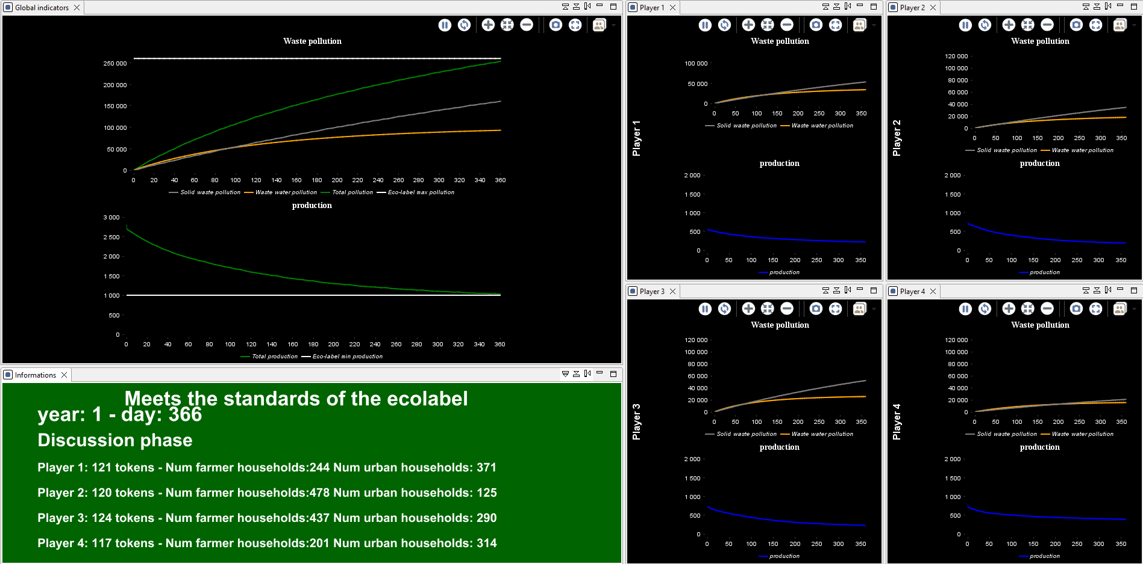
Maps and displays
The players will have several pieces of information to guide their choice
First, they will have access to the pollution and production of each village (individual indicators) and of the commune (global indicators)

Slide 11
Maps and displays
Second, the players will be able to navigate between different representation of the territory through 4 maps :
Global pollution location
Solid waste pollution
Canals pollution
Production map

